Slide 1
Machine Learning in Business
Delivering an ML/AI Strategy, AI for Business Leaders, Udacity
Osama Hosameldeen, Feb - 2020

Slide 2
Executive Summary
Purpose of Project
In business, too much data are there. We are drowning in data but starving for knowledge
If we don’t have the ability to adopt AI in business, we will be back in time and space.
Methodology
Analysis conducted over 4 weeks
Over 5 potential use cases underwent thorough assessment for feasibility and impact
Incorporated both technical knowledge and user feedback
Path Forward
2 use cases identified for implementation
Technology and Black Box AI usage are two important concepts.
Next steps

Slide 3
I began with five use case ideas
Quality Control with Computer Vision
The devices will be checked using CV to check if it is defective or not
Car Maintenance Expectation
expect time of next problem occurrence, get ready to make the fix ahead of time
Recruit Screener
AI will be used as a helper or job assistant in HR department
Supply Chain Costs Prediction
collect data about transportation and costs and switching costs, predict the supply costs.
Car Detection of Customer ID
Camera can detect the customer face to define the customer id, car preferences are changed automatically

Slide 4
I assessed feasibility vs. impact for all cases
UC 1
UC 4
Key criteria assessed
Computer Vision
Ease of use
Complexity/Usability
Clear Process understanding
Cost of hardware
UC 3
Impact
UC 5
UC 2
Feasibility

Slide 5
Transforming our business using ML/AI with these top two use cases
Quality Control with Computer Vision
The quality control can be controlled totally on visual classification. In which it can be either binary classifier, so the classifier can detect the existence/absence of the defective or classify multiple defectives.
Car Maintenance Expectation
The basic principle is to use the reading from the sensors in the automobile to check for the expected upcoming failure. Regression can use the failure as a dependent variable and the reading from the sensors as the independent variable
By executing on these two projects I believe we can drive user satisfaction for our business by adopting AI and become an attractive business.

Slide 6
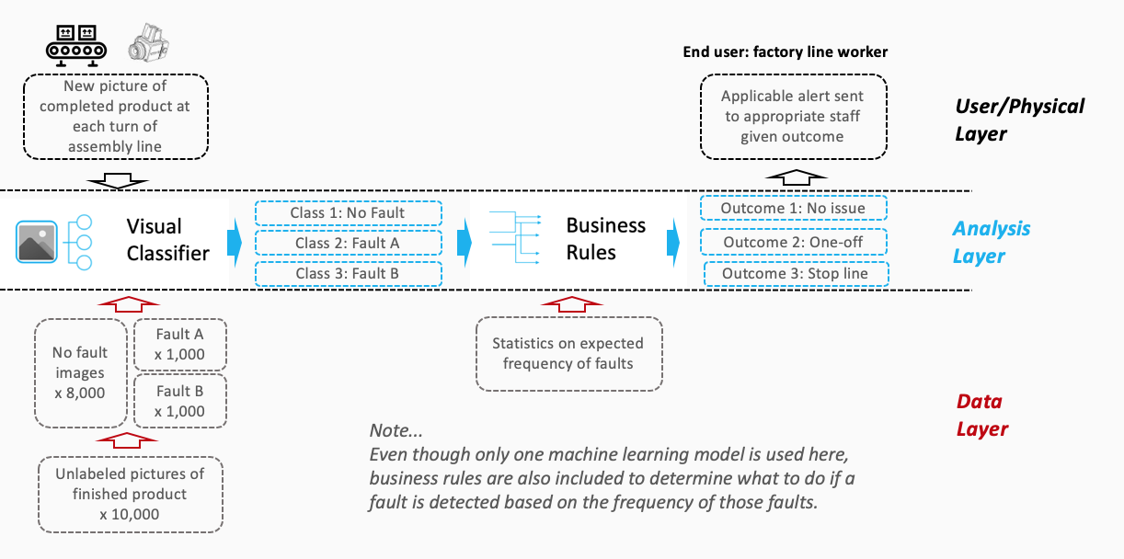
Quality Control with Computer Vision (Use case) Deep Dive
Process Today
Direct contact and destructive inspection
Extensive human intervention
Less quality
High labor costs
Highly costs.
Example Architecture
Process Tomorrow
Enabling non-contact, thus non-destructive inspection
minimize human intervention
optimize operational efficiency
reduce labor costs
increased profits of the enterprise
The impact of Quality with CV will be amazing thanks to Computer Vision

Slide 7
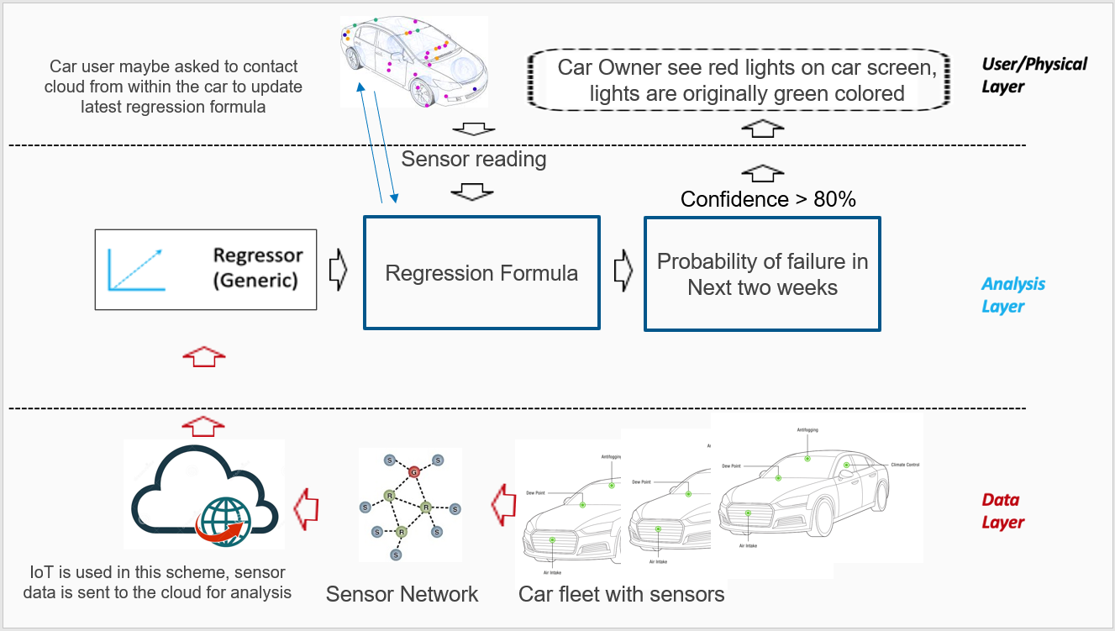
Car Maintenance Expectation (Use case) Deep Dive
Process Today
The problem happens first then a plan for maintenance comes
We don’t expect which car need maintenance first.
Example Architecture
Process Tomorrow
proactive maintenance predictor
identify and prioritize trucks that require immediate service
You can reliably predict faults before they occur
The impact of Car Maintenance will be amazing thanks to AI.

Slide 8
Risks/Mitigations
 | Quality Control with Computer Vision | Car maintenance Expectation
Accuracy Definition | Concerns: illumination, camera space Plan: put reasonable lights and get extra space for the camera. | Concerns: sensor hardware faults Plan: make backup sensors and make sure that the sensors has direct effect on the overall decision
Underfitting/Overfitting Definition | Concerns: overfitting Plan: user different datasets for training and testing | Concerns: security Plan: encryption can be adopted for securing transformation of data to the cloud
Ethical Concerns Definition | Concerns: not exist Plan: | Concerns: not exist Plan:

Slide 9
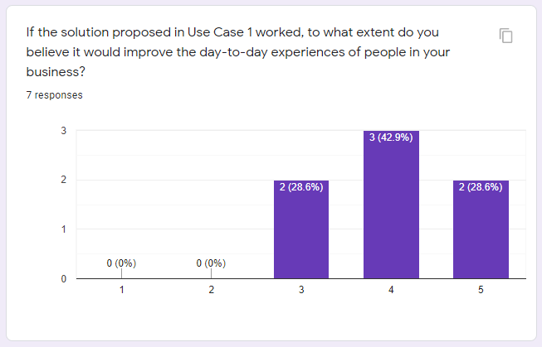
Feedback Thus Far- Quality control with CV
Illustrative Verbatim Quotes
Proposed Next Steps
Buy and install camera on the production line. And make prototype model for it.
Collect images for defects and train AI model on them
If the proposed solution Could be developed it will make the process of inspecting the quality of products easy
Value added with automatic inspection
Training the classifier to predict n classes
Proposed Timeline
Illustrative Visualization
Month 1
Install and test the camera.
Collect dataset
Labeling dataset
Month 2
Implementing the AI model, train it, test it, measure accuracy
Month 3
Make initial prototype.

Slide 10
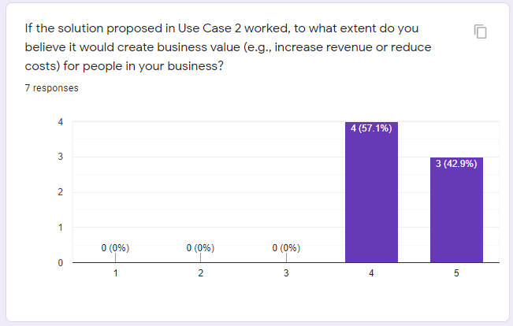
Feedback Thus Far- Car maintenance Expectation
Illustrative Verbatim Quotes
Proposed Next Steps
Install sensors in the car and start collecting data.
When enough data is collected, (they maybe expected to last for months in new cars) we train our model
Imagine that I have a solution to tell me that you will be sick next week Sunday. It will be amazing if it is done in automobile industry
It will solve a problem faced by a lot of users
Its an Application of IOT Field, So it will capture the interest of a lot of people
Proposed Timeline
Illustrative Visualization
Phase 1
Install sensors and start collecting data
Phase 2
Train our regression model with the collected data.
Test the model
Phase 3
Create initial prototype.

